Slide 1
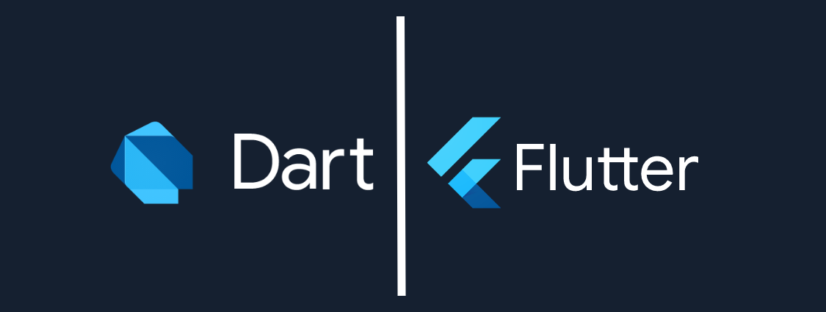
DART AND FLUTTER

Slide 2

WHAT IS DART..??
Dart is an open-source and object-oriented programming language. It is originally developed by Google and later approved as a standard by ECMA (European Computer Manufacturers Association).
The purpose of Dart programming is to create a frontend user interfaces for the web and mobile apps.
Dart also forms the foundation of Flutter. Dart provides the language and runtimes that power Flutter apps, but Dart also supports many core developer tasks like formatting, analyzing, and testing code.

Slide 3
DART VS JAVASCRIPT
Similarly to JavaScript, Dart can be used for both mobile and web
development. Dart became popular along with the Flutter framework
for developing cross-platform mobile
apps. Dart can be also used for developing web apps, but is actually used for this purpose very rarely.

Slide 4
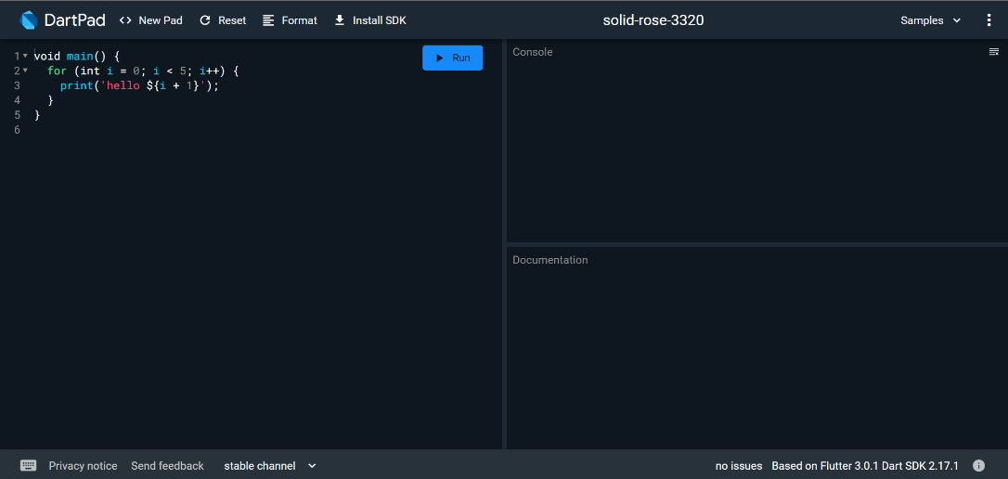
DART PAD
The Dart team created DartPad at the start of 2015, to provide an easier way to start using Dart. It is a fully online editor from which users can experiment with Dart application programming interfaces (APIs), and run Dart code.

Slide 5
WHERE CAN I USED DART?
Dart is a general-purpose language, and you can use it for almost anything:
In mobile applications thanks to Flutter.
In console applications.
In web applications

Slide 6
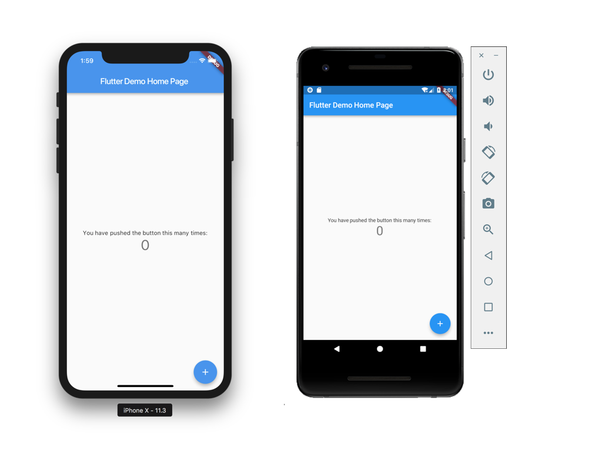

WHAT IS FLUTTER ?
Flutter is an open-source
UI Software Development Kit created by google,
which allows you to make cross platform applications (Android and iOS).

Slide 7
WHY FLUTTER..??
Following are some benefits of flutter:
FLUTTER IS CROSS-PLATFORM
Flutter is a cross-platform development tool. That means software developers can use the same code base for building an iOS and Android app.
OPEN SOURCE
Flutter is an open-source technology both Dart and Flutter are free to use.
Good documentation.
You can learn a lot from Flutter's documentation, and everything is very detailed with easy examples for basic use cases.

